Slide 1
Organisation of Data

Slide 2

What is a Database?
A collection of organised data
Data has structure
Can be paper-based

Slide 3
Flat File Databases
A flat-file database is a simple database that stores all data in a single table
A flat-file database can be stored in a text file, such as a tab-delimited file; a spreadsheet; or in a database file that contains one or more unrelated tables.

Slide 4
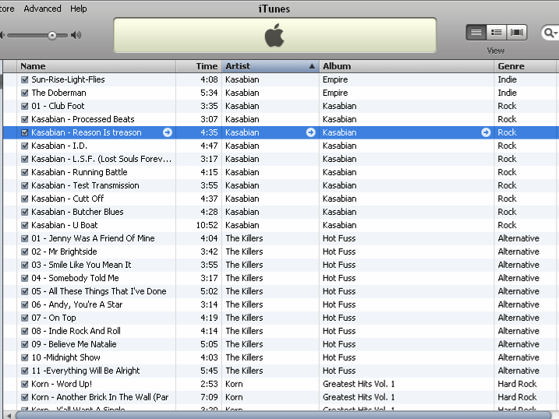
no

Slide 5
Database Concepts
Flat file example
Record
A single record will hold all the data relating to one unit of processing. e.g a track
Field
A field stores one item of data for the record
File
Data file contains a number of records

Slide 6
Database Concepts
Data types (Access specific)
There are 5 main data types
Text
Characters
Numeric
Numbers
Date
Various formats
Boolean
True/False
Counter
Auto-inserted no.

Slide 7
Flat File Databases
Useful for simple lists:
Address book/contact list
CD collection
But many problems
You’ll usually be asked to identify FOUR problems with flat files in the exam so pay attention to the next few slides!

Slide 8
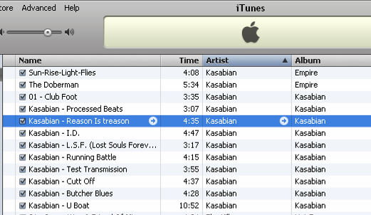
Problems with flat files
Redundancy
Large amounts of duplicated data
Makes data entry slower
Uses disk space
Leads to other problems…

Slide 9
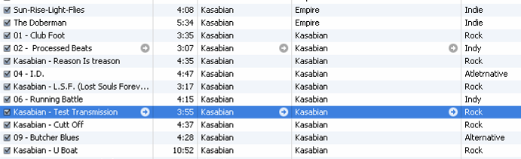
Problems with flat files
Reduced data integrity
More likely to be inaccurate!
Due to:
Data input errors
Inconsistent data entry

Slide 10
Flat files – more problems
Difficult to update
If entries change all instances have to be updated
Security
All users have access to the same set of data
Program-Data Dependence
The user interface (amongst other things) is tied to a specific file. To create new views of data you would need to create new data files

Slide 11
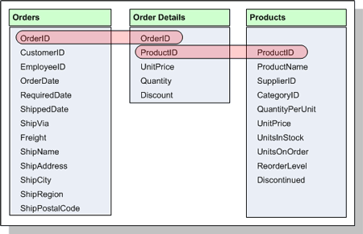
Overcoming problems - RDBMS
The problems associated with flat files can be solved by moving some of the data out of the main table and accessing it when required
A relational database (RDBMS) is a more complex database that stores data in multiple tables that are interrelated.

Slide 12
RDBMS
In the example on the previous slide there is still a problem in the ORDERS table. How would you resolve it?
Relational databases are covered in more detail in another presentation. For now it is only important that you can identify the benefits of RDBMS over flat file systems…

Slide 13
RDBMS - benefits
Reduced redundancy
Improved data consistency
Improved data integrity
Better security
Program-data independence

